Slide 1
راك كېسىلىنىڭ ئالدىنى ئېلىش توغرىسىدا ساۋاتلار
باھارگۇل ئاتانۇر
2023-يىلى 26-يانۋار
Notes:
This template can be used as a starter file to give updates for project milestones.
Sections
Right-click on a slide to add sections. Sections can help to organize your slides or facilitate collaboration between multiple authors.
Notes
Use the Notes section for delivery notes or to provide additional details for the audience. View these notes in Presentation View during your presentation.
Keep in mind the font size (important for accessibility, visibility, videotaping, and online production)
Coordinated colors
Pay particular attention to the graphs, charts, and text boxes.
Consider that attendees will print in black and white or grayscale. Run a test print to make sure your colors work when printed in pure black and white and grayscale.
Graphics, tables, and graphs
Keep it simple: If possible, use consistent, non-distracting styles and colors.
Label all graphs and tables.

Slide 2
ئىزاھات
بۇ لىكسىيە پەقەت ئۇيغۇر خانىم-قىزلىرىنىڭ پايدىلىنىشى ئۈچۈن تۈزۈلدى.
Notes:
* If any of these issues caused a schedule delay or need to be discussed further, include details in next slide.

Slide 3
مۇھىم مەزمۇنلار
راك دىگەن نېمە ۋە قانداق پەيدا بولىدۇ؟
راك كېسىلىنىڭ ئالدىنى ئېلىش ئۈچۈن نىمىلەرگە دىققەت قىلىشىمىز كېرەك؟
راك كېسىلىنىڭ ئالدىنى ئېلىشتا يىمەك ئىچمەك قانداق رول ئوينايدۇ؟
راك كېسىلىنىڭ ئالدىنى ئېلىشتا چېنىقىشنىڭ قانداق رولى بار؟
باشقا كۈندۈلۈك تۇرمۇشىمىزدىكى مۇھىم ئامىللار-ئۇخلاش،ساغلام روھى كەيپىيات قاتارلىقلار
بەزى ۋاكسىنلارنىڭ راك كېسىلىنىڭ ئالدىنى ئېلىشتىكى رولى
راك كېسىلىنى بالدۇر بايقاش ئۈچۈن قىلىنىدىغان تەكشۈرۈشلەرنى ۋاختىدا تەكشۈرتۈشنىڭ مۇھىملىقى ھەققىدە
Notes:
* If any of these issues caused a schedule delay or need to be discussed further, include details in next slide.

Slide 4
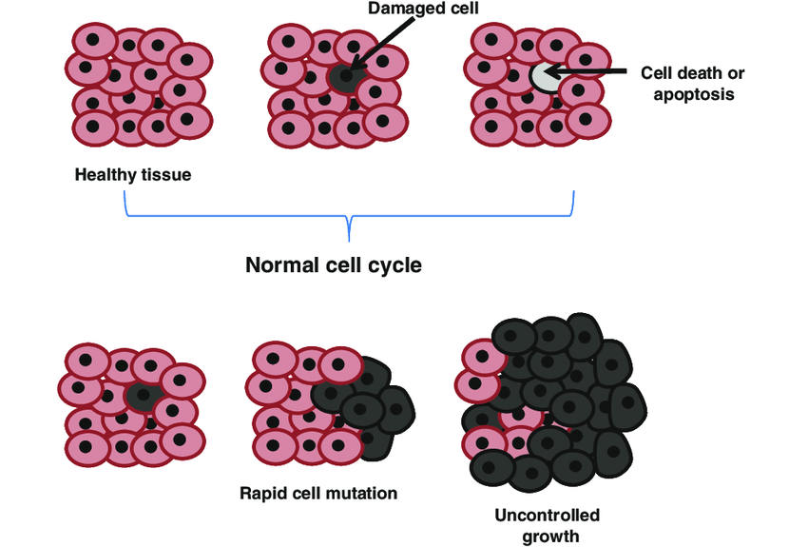
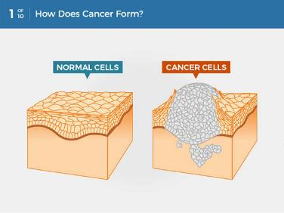
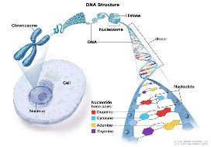
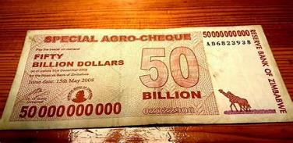
راك دىگەن نىمە؟
Notes:
* If any of these issues caused a schedule delay or need to be discussed further, include details in next slide.

Slide 5
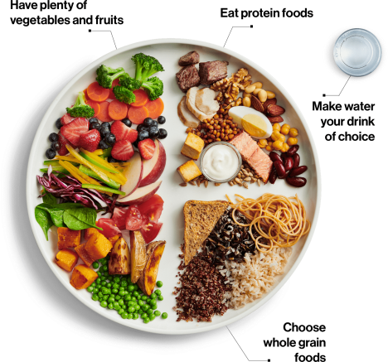
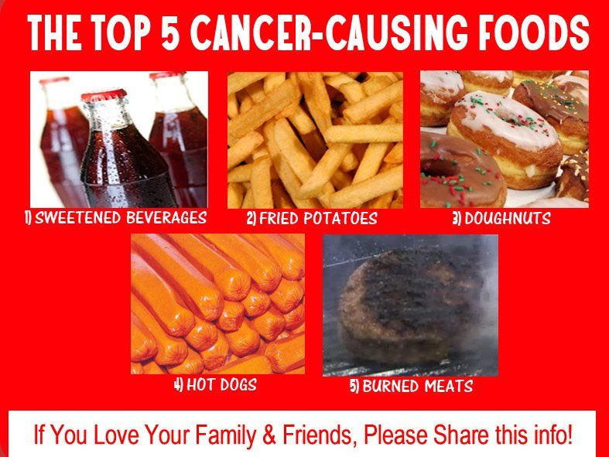
يىمەك ئىچمەكلەر
كۆپ مىقداردا سەي-كۆكتات ۋە مىۋەلەر
ئاقسىل ماددىلىق يىمەكلىكلەر
ئىچىملىك ئۈچۈن سۇنى تاللاش
دانلىق زىرائەتلىك يىمەكلىكلەر
Notes:
* If any of these issues caused a schedule delay or need to be discussed further, include details in next slide.

Slide 6
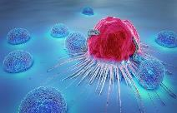
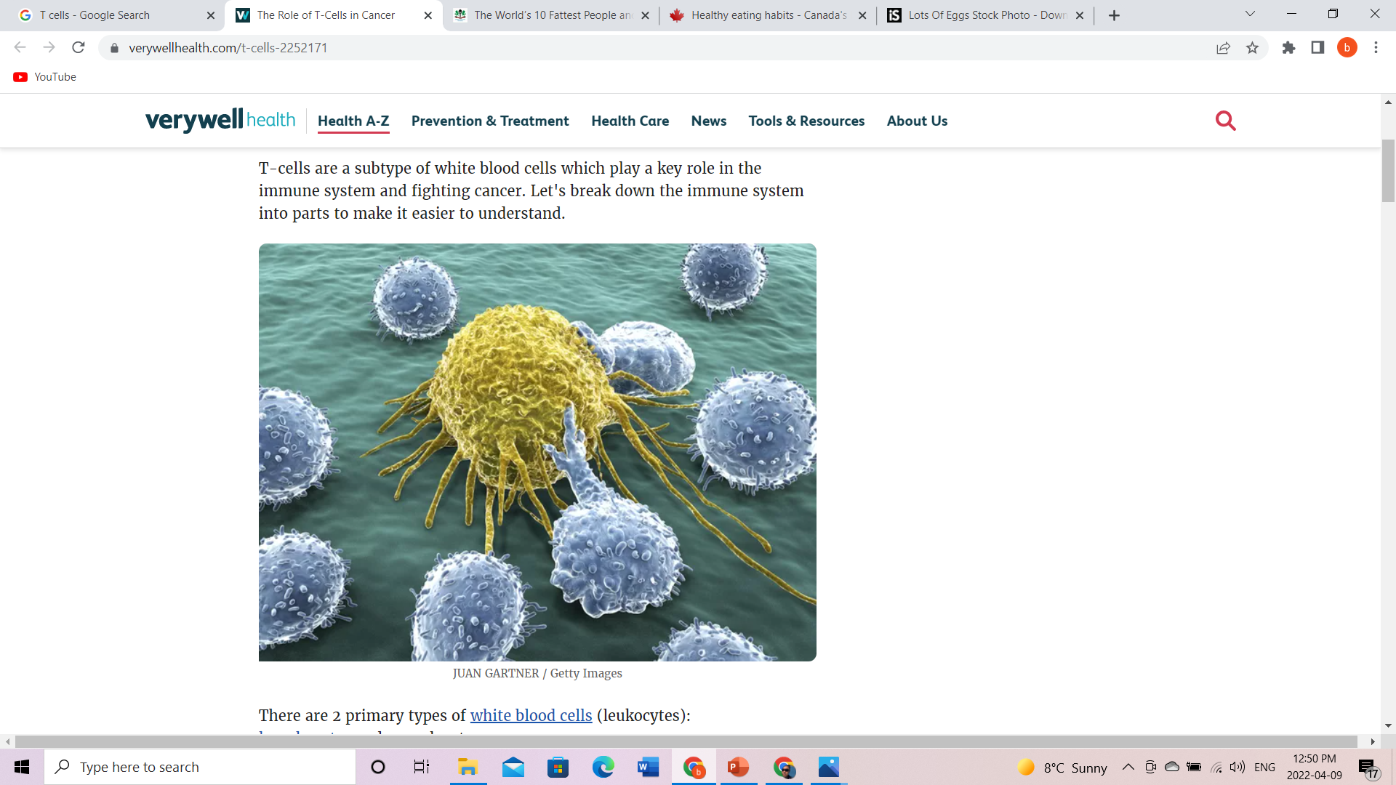
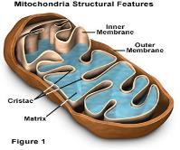
قەرەللك روزا تۇتۇش
راك كىسىلىگە بولغان پايدىلىق تەرەپلىرى
راك ھۈجەيرىلىرىنى ئاچ قالدۇرۇپ راك كىسىلى بولۇش نىسبىتىنى تۆۋەنلىتىدۇ
بەدەننىڭ ئوكسىدلاشقا قارشى كۈچىنى ئاشۇرىدۇ
ياللۇغلىنىشقا قارشى كۈچىنى ئاشۇرىدۇ
كىسەلگە قارشى كۈچىنى ئاشۇرىدۇ (ئۆلتۈرگۈچى T ھۈجەيرىلەر ۋە ياردەمچى T ھۈجەيرىلىرىنى كۈچلەندۇرىدۇ)
كونا ھەم بۇزۇلغان ئاقسىللارنى ئەسلىگە كەلتۈرىدۇ
Notes:
* If any of these issues caused a schedule delay or need to be discussed further, include details in next slide.

Slide 7
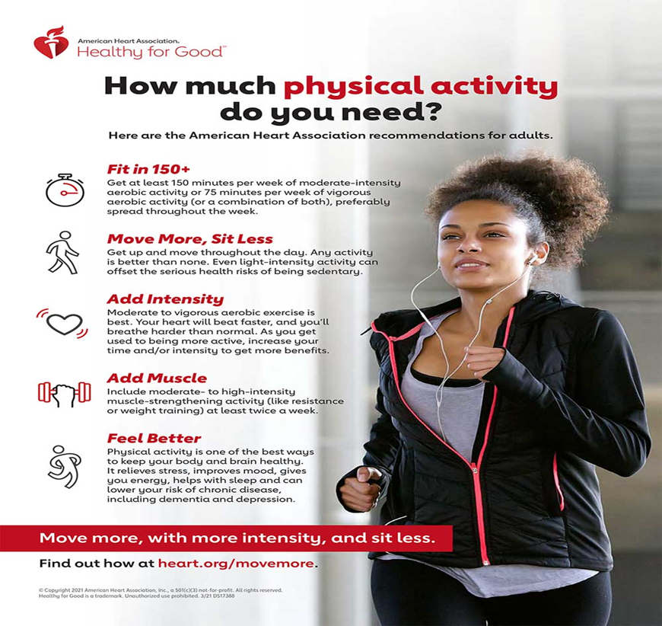
چېنىقىش
Notes:
* If any of these issues caused a schedule delay or need to be discussed further, include details in next slide.

Slide 8
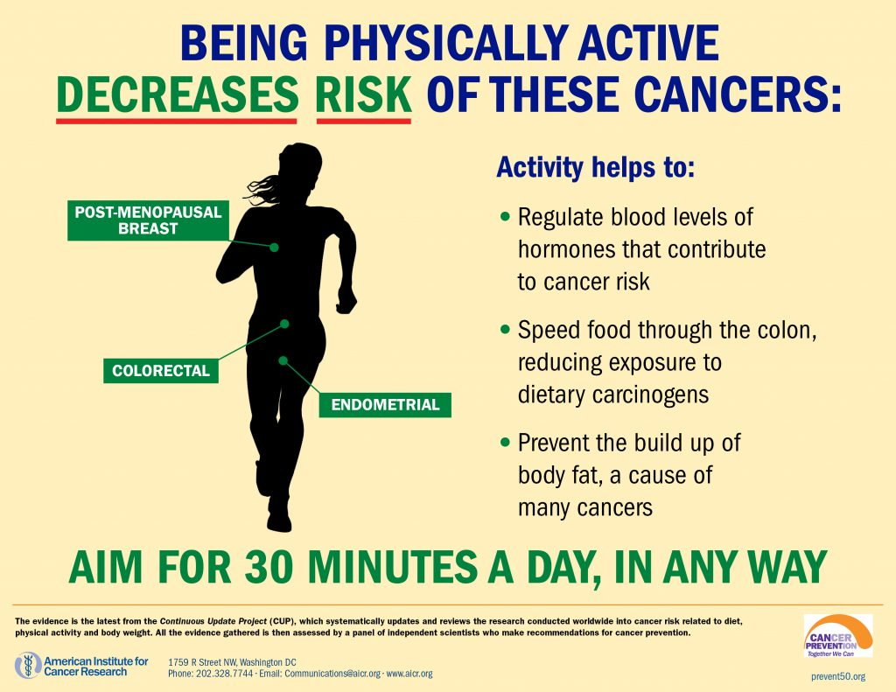
چېنىقىشنىڭ رولى
Notes:
* If any of these issues caused a schedule delay or need to be discussed further, include details in next slide.

Slide 9

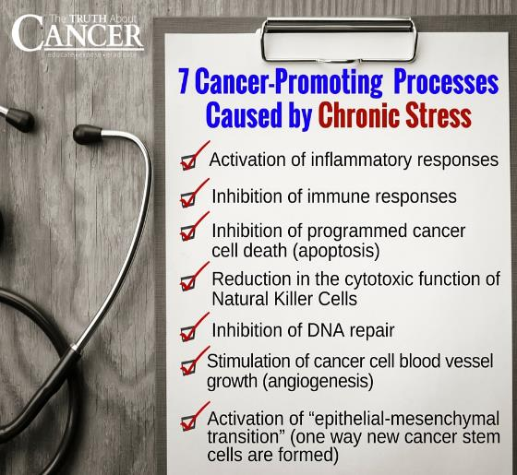

ئۇزۇن مەزگىللىك بېسىم
Notes:
* If any of these issues caused a schedule delay or need to be discussed further, include details in next slide.

Slide 10
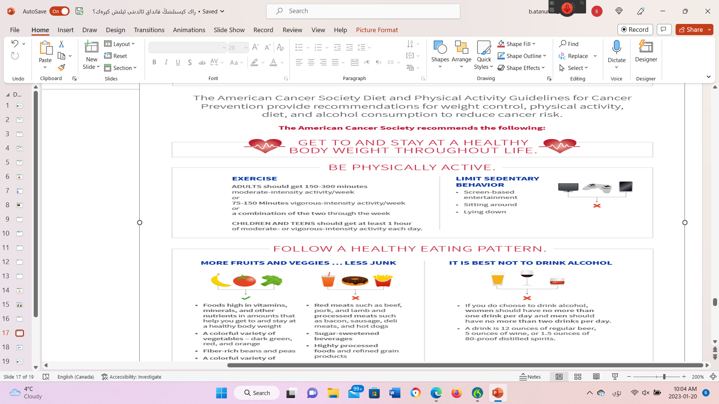
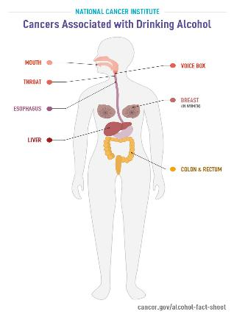

ھاراق ئىچىش
Notes:
* If any of these issues caused a schedule delay or need to be discussed further, include details in next slide.

Slide 11
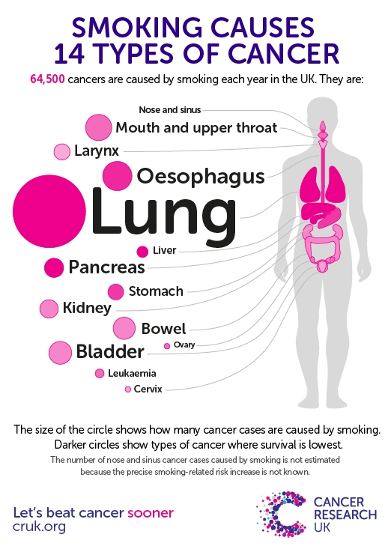

تاماكا چېكىش
Notes:
* If any of these issues caused a schedule delay or need to be discussed further, include details in next slide.

Slide 12
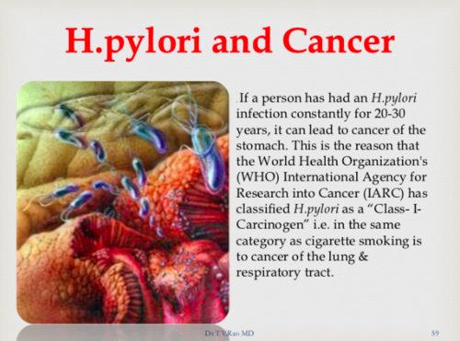
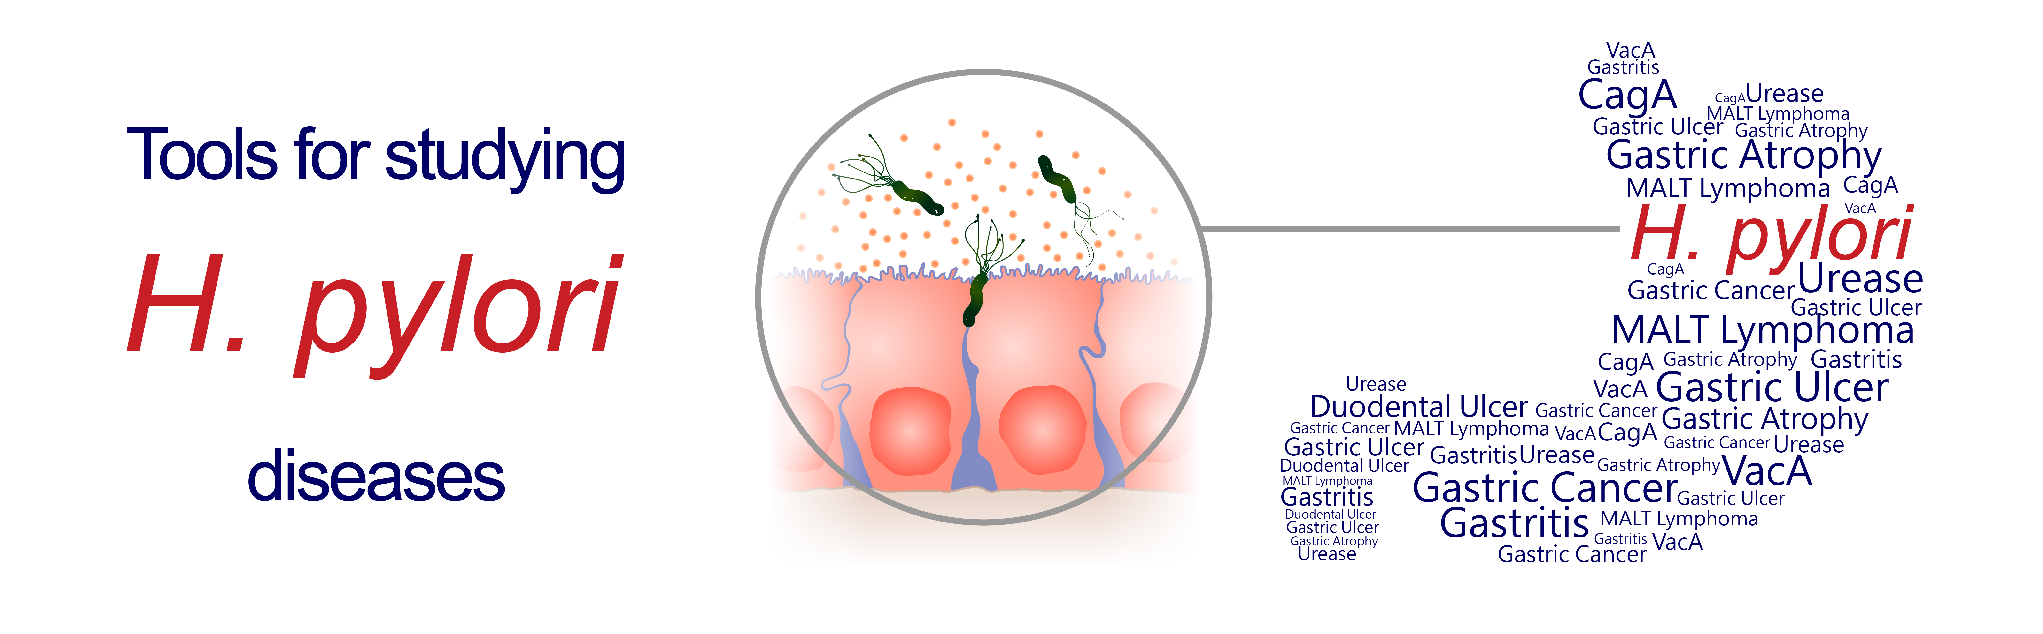
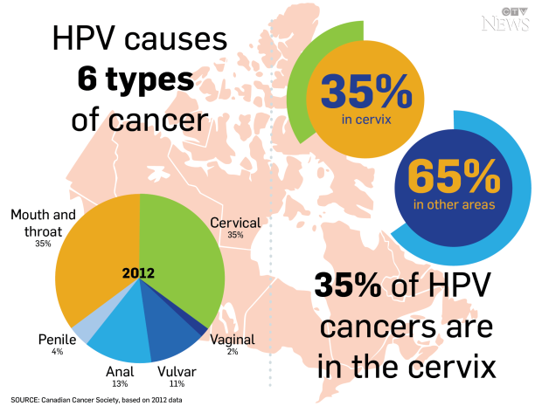
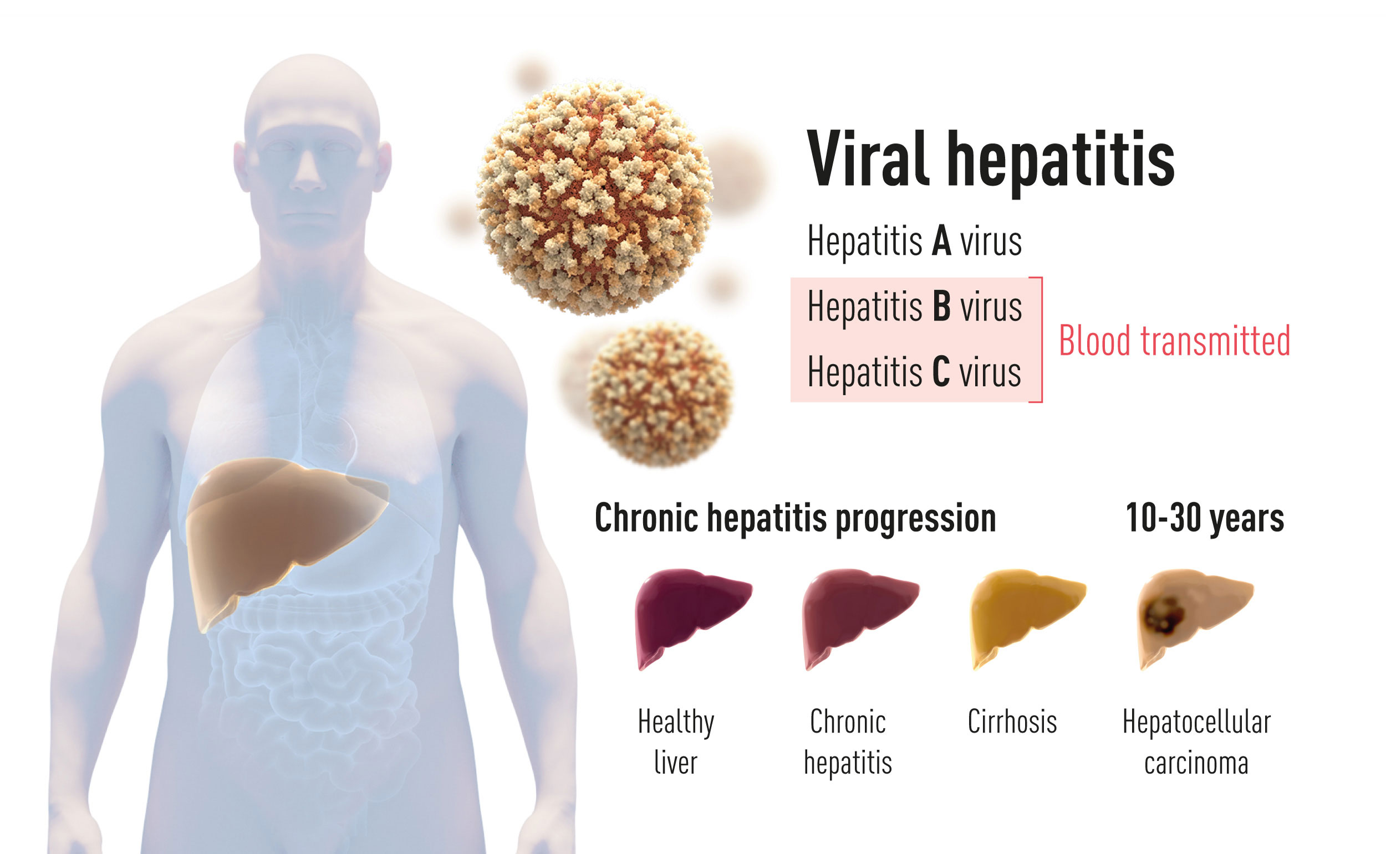
)Infection( باكتېرىيە ۋىروسلار بىلەن يۇقۇملۇنۇش
Notes:
* If any of these issues caused a schedule delay or need to be discussed further, include details in next slide.

Slide 13
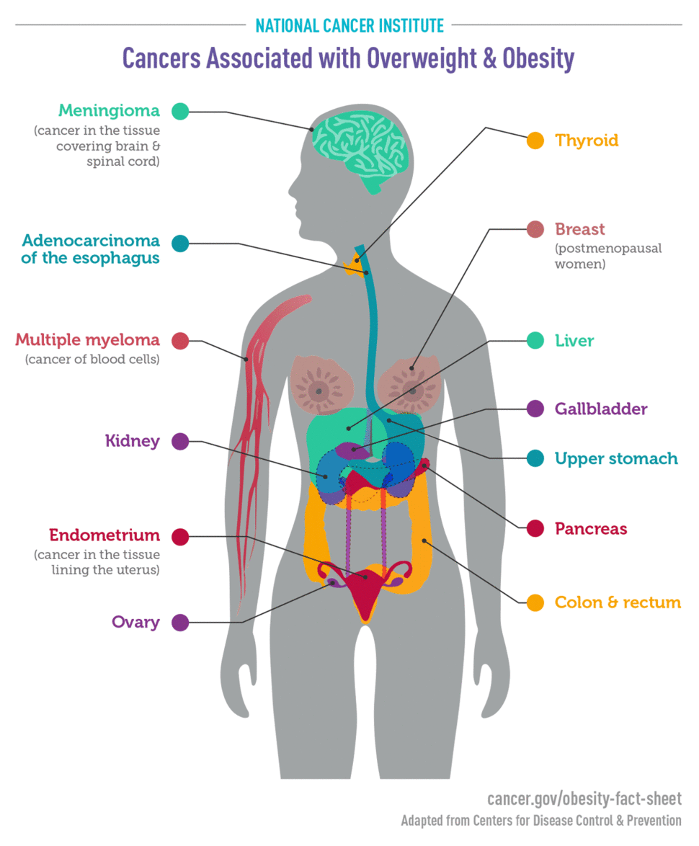
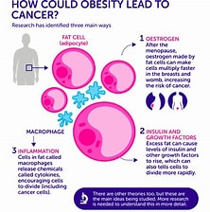
سىمىزلىك
Notes:
* If any of these issues caused a schedule delay or need to be discussed further, include details in next slide.

Slide 14

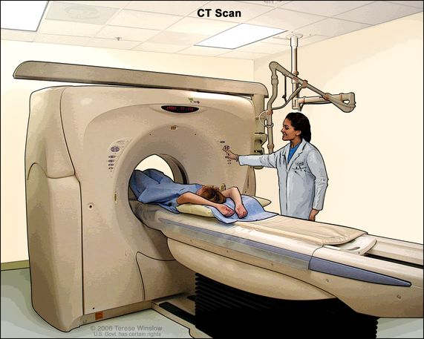
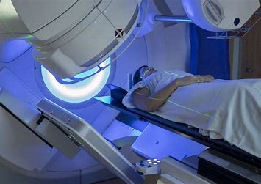
رادىيەكسىيە
https://www.bing.com/videos/search?q=radon+and+cancer&&view=detail&mid=4E3D3C65D85ED5F569284E3D3C65D85ED5F56928&&FORM=VRDGAR&ru=%2Fvideos%2Fsearch%3Fq%3Dradon%2Band%2Bcancer%26FORM%3DHDRSC4
Notes:
* If any of these issues caused a schedule delay or need to be discussed further, include details in next slide.

Slide 15


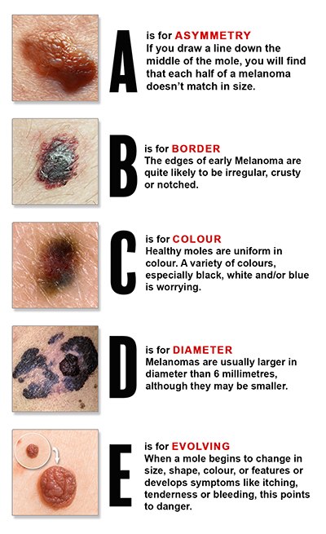

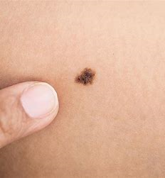
كۈن نۇرى
Notes:
* If any of these issues caused a schedule delay or need to be discussed further, include details in next slide.

Slide 16
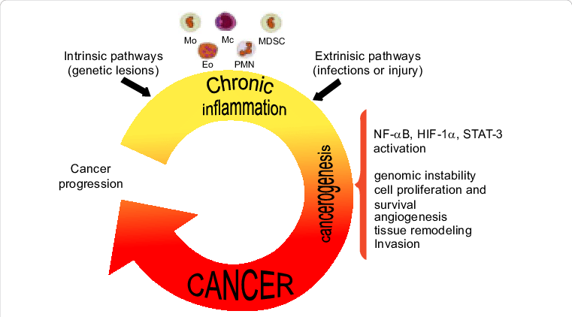

ئاستا خاراكتىرلىق ياللۇغلىنىش
Notes:
* If any of these issues caused a schedule delay or need to be discussed further, include details in next slide.

Slide 17
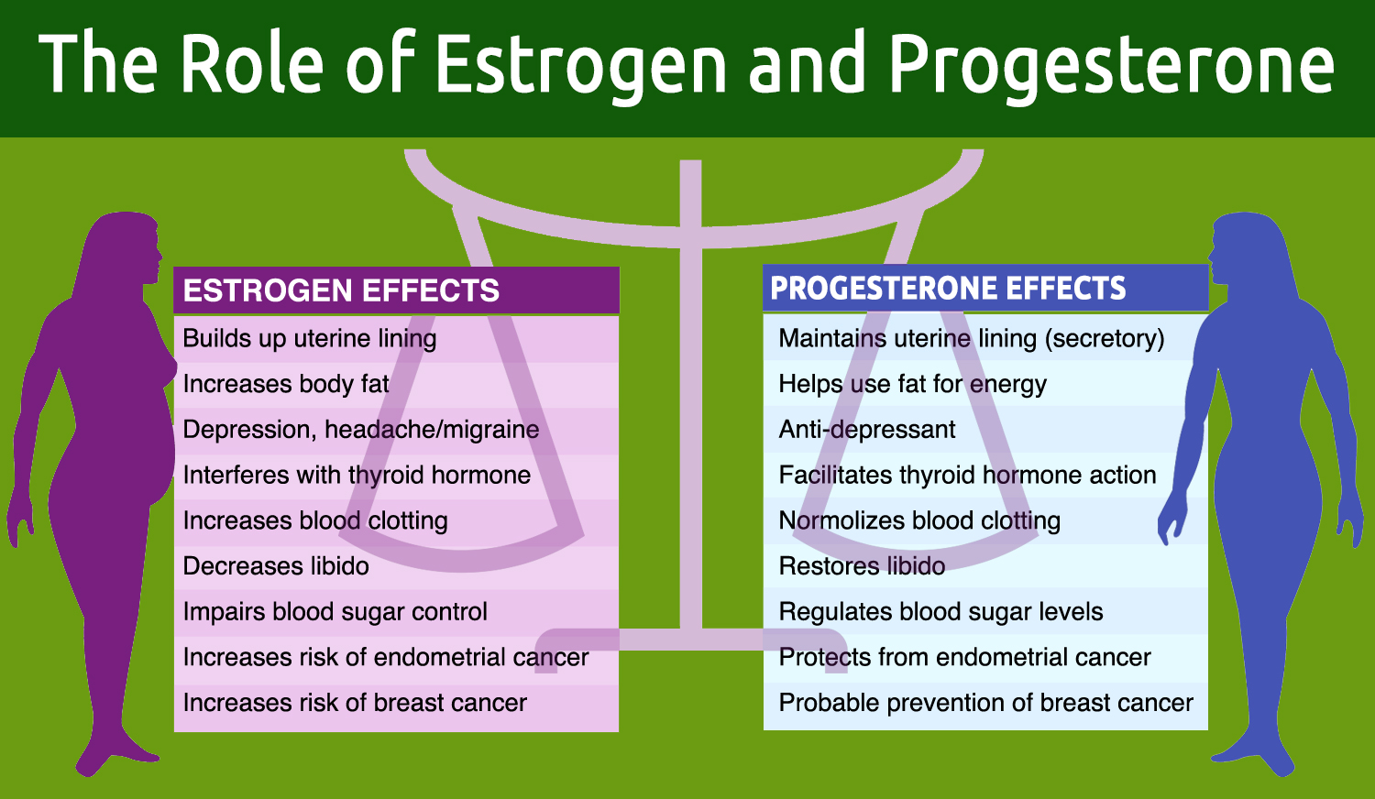
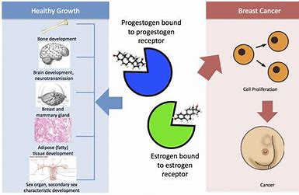
ھورمۇنلار
Notes:
* If any of these issues caused a schedule delay or need to be discussed further, include details in next slide.

Slide 18




ھورمۇنلار
Notes:
* If any of these issues caused a schedule delay or need to be discussed further, include details in next slide.

Slide 19
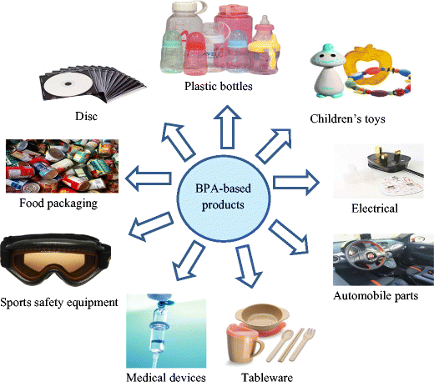


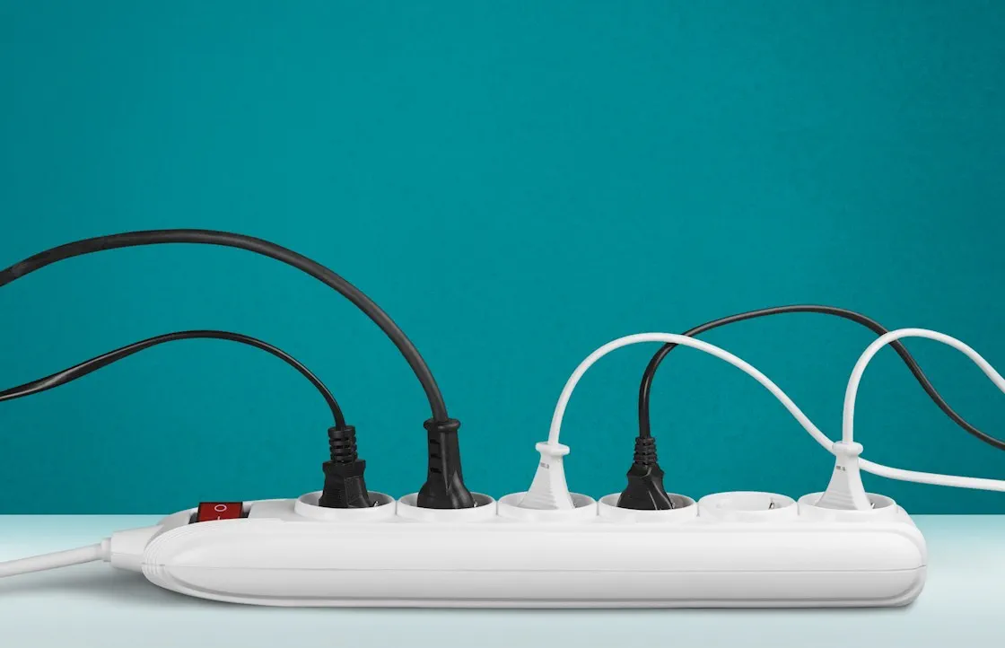



ھورمۇنلار
Notes:
* If any of these issues caused a schedule delay or need to be discussed further, include details in next slide.

Slide 20
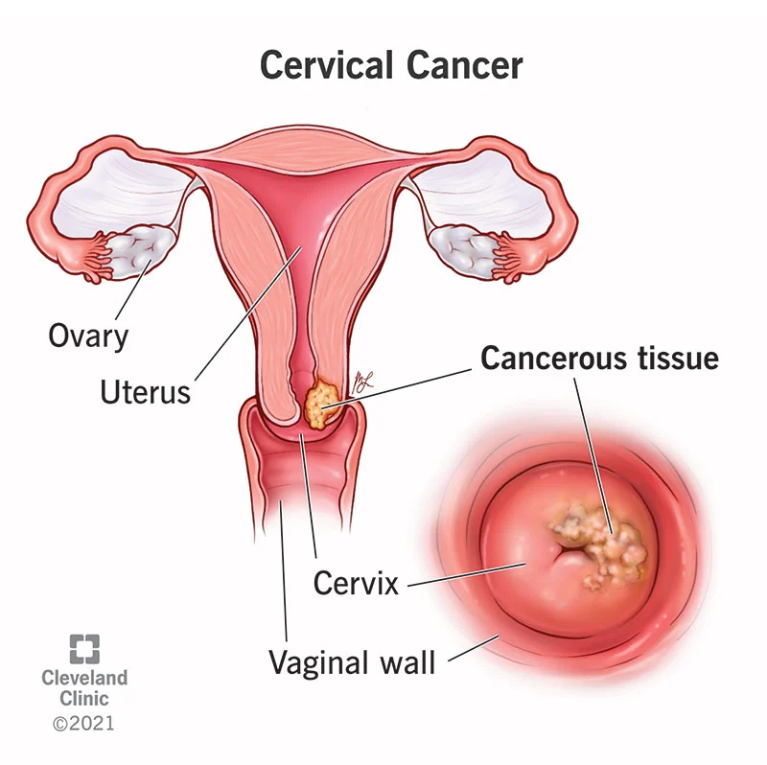

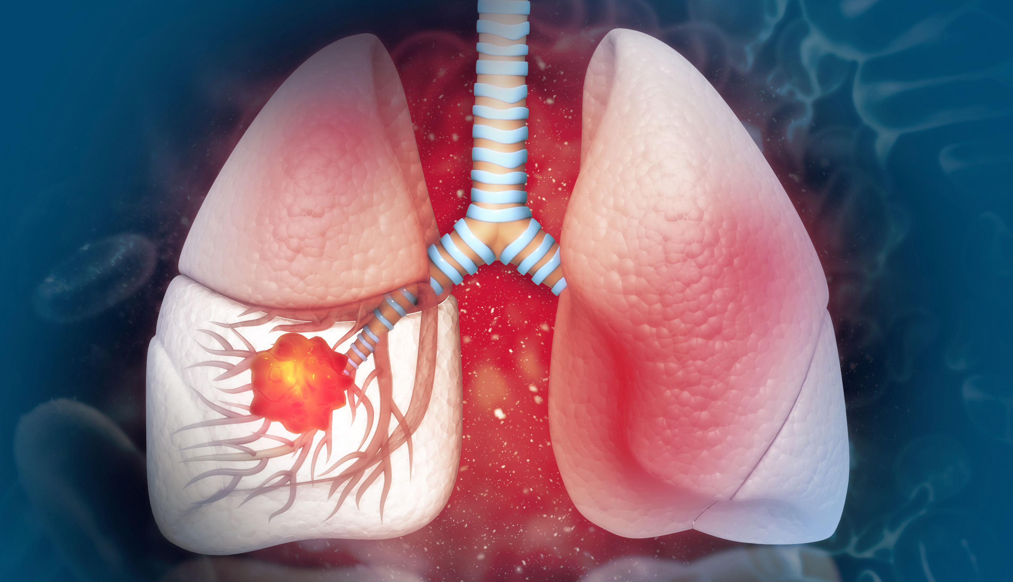
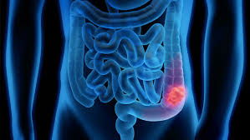
قەرەللىك تەكشۈرۈشلەر
Notes:
* If any of these issues caused a schedule delay or need to be discussed further, include details in next slide.

Slide 21

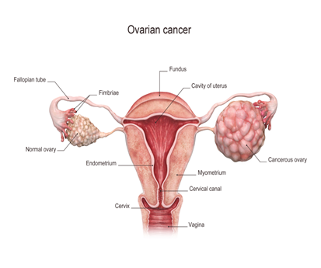
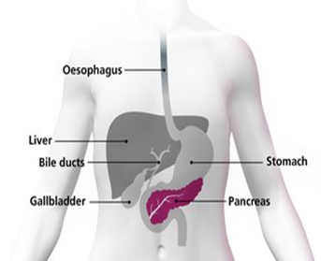
قەرەللىك تەكشۈرۈشلەر
Notes:
* If any of these issues caused a schedule delay or need to be discussed further, include details in next slide.

Slide 22
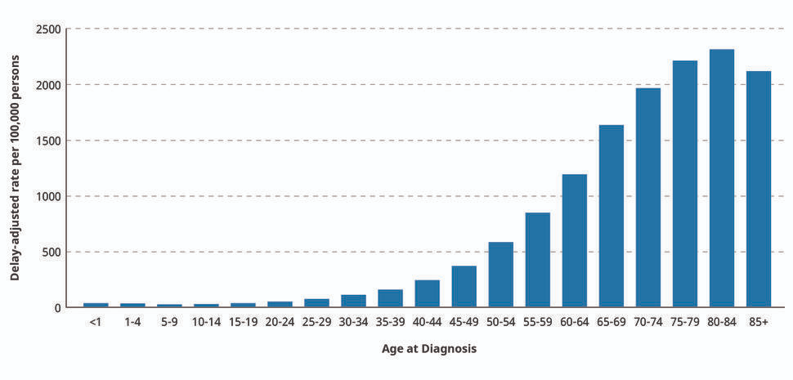
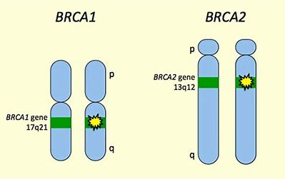

ياش ۋە ئېرسىيەت
Notes:
* If any of these issues caused a schedule delay or need to be discussed further, include details in next slide.

Slide 23
راك پەيدا قىلغۇچى ماددىلار
Aflatoxins
Aristolochic Acids
Arsenic
Asbestos
Benzene
Benzidine
Beryllium
1,3-Butadiene
Cadmium
Coal Tar and Coal-Tar Pitch
Coke-Oven Emissions
Crystalline Silica (respirable size)
Erionite
Ethylene Oxide
Formaldehyde
Hexavalent Chromium Compounds
Indoor Emissions from the Household Combustion of Coal
Mineral Oils: Untreated and Mildly Treated
Nickel Compounds
Radon
Secondhand Tobacco Smoke (Environmental Tobacco Smoke)
Soot
Strong Inorganic Acid Mists Containing Sulfuric Acid
Thorium
Trichloroethylene
Vinyl Chloride
Wood Dust
Notes:
* If any of these issues caused a schedule delay or need to be discussed further, include details in next slide.

Slide 24
پايدىلانغان مەنبەلەر
https://food-guide.canada.ca/en/
Search – UpToDate
https://www.bing.com/images/search?view=detailV2&ccid=g5ndv3Y1&id=F1B796F643404311B81AD6BCB99A0293684CE034&thid=OIP
https://www.cancer.gov/
https://cancer.ca/en/cancer-information/reduce-your-risk/understand-hormones/all-about-hormones
https://my.clevelandclinic.org/health/diseases/12216-cervical-cancer
https://www.saintjohnscancer.org/gynecology/conditions-we-treat/ovarian-cancer/
https://www.gutlove.com/blog-1/2017/7/2/helicobacter-pylori-h-pylori-an-all-too-common-cancer-causing-gi-infection
https://www.bing.com/image
https://www.epa.gov/sites/default/files/2016-12/documents/2016_consumers_guide_to_radon_reduction.pdf
https://www.drberg.com/blog/intermittent-fasting-and-cancer
Notes:
* If any of these issues caused a schedule delay or need to be discussed further, include details in next slide.

Slide 25
رەھمەت!!!

